Slide 1
Интернет вещей и «умных» устройств
Лекция 1
Интернет вещей
Internet of Things

Slide 2
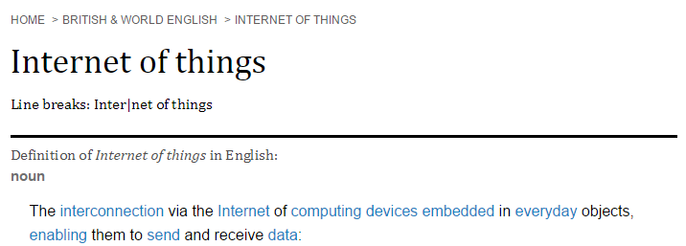
Definition

Slide 3
Definition

Slide 5
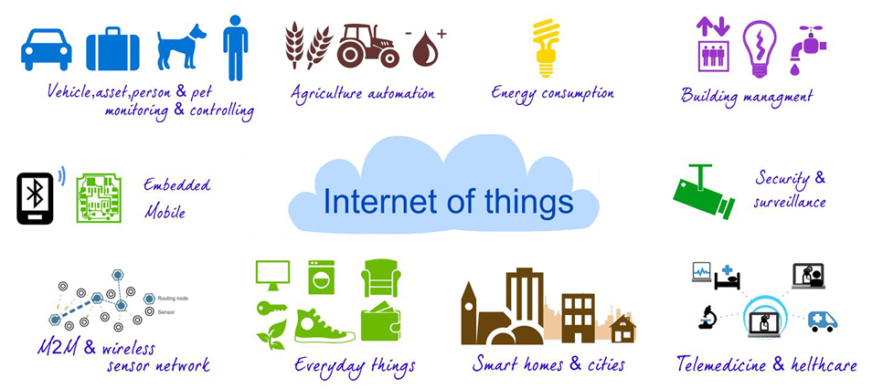

Slide 6
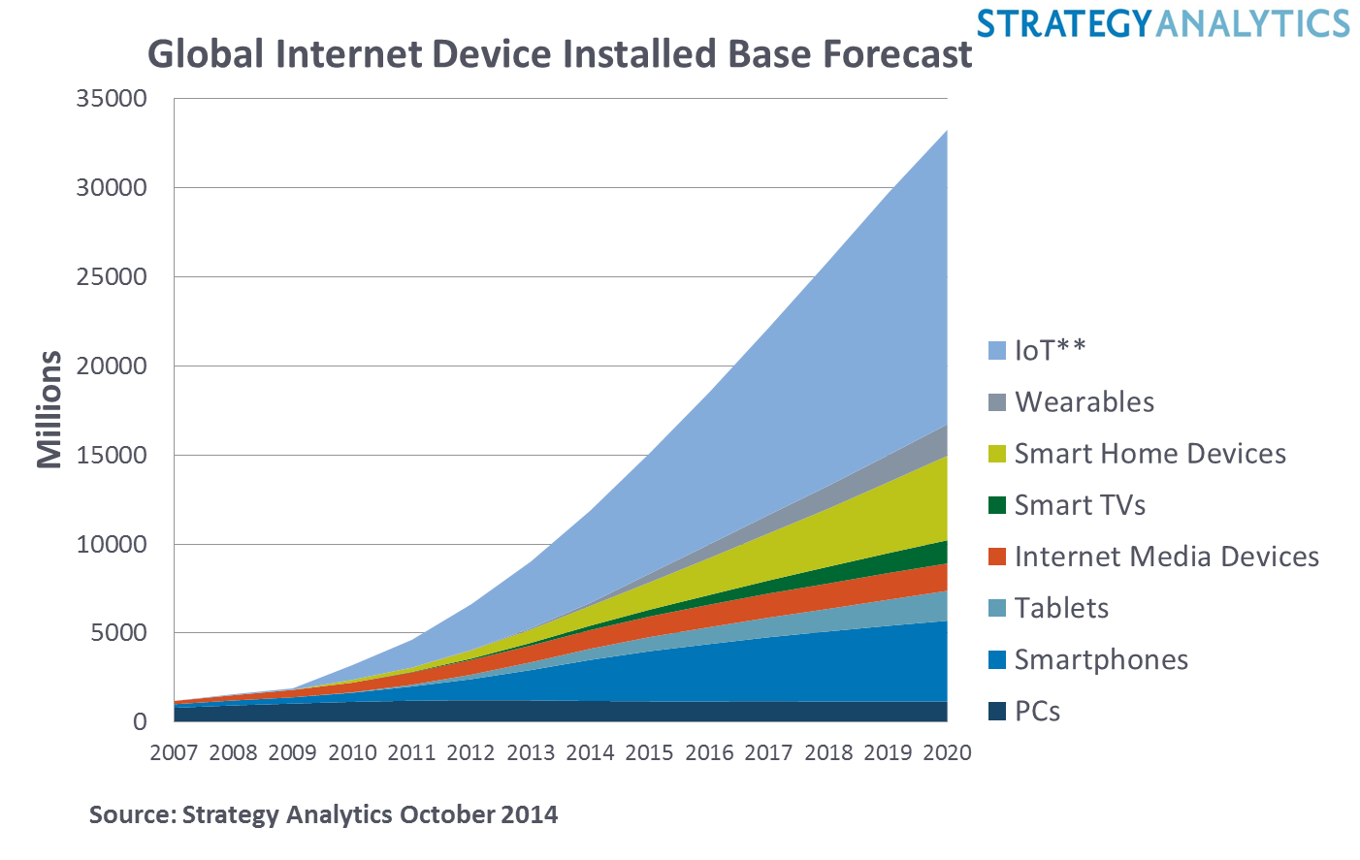

Slide 8
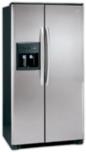
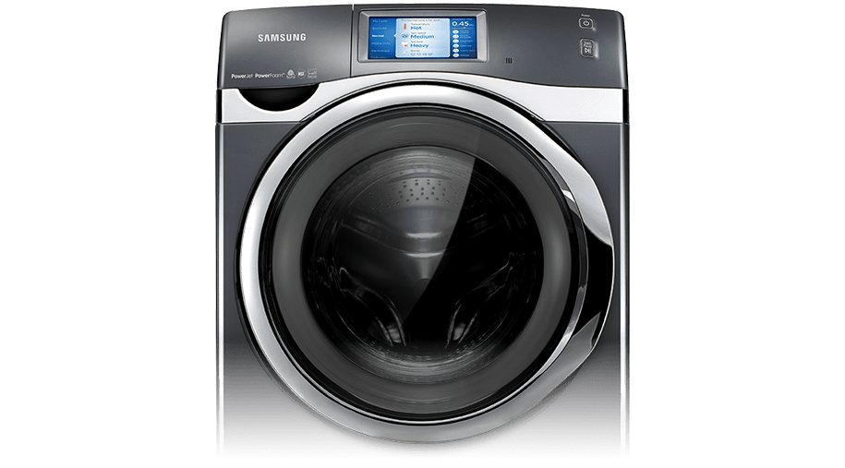
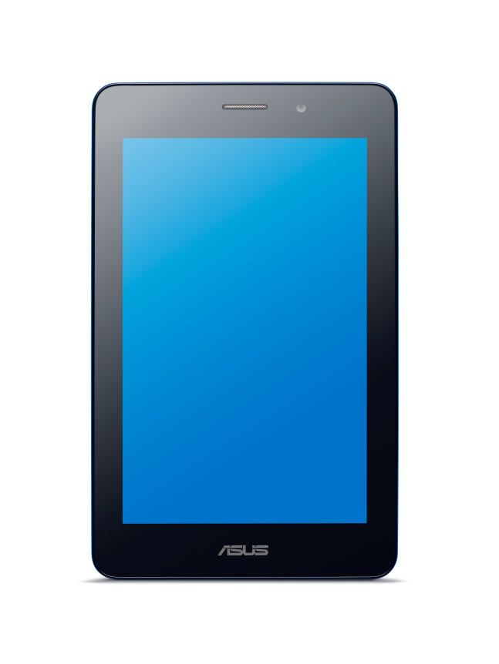
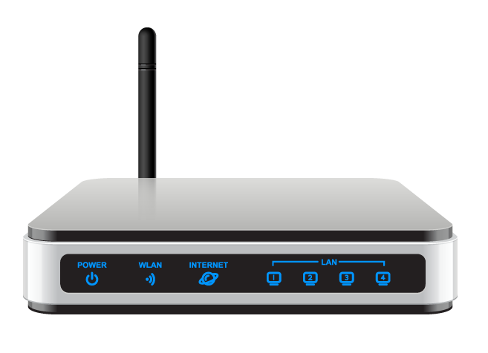
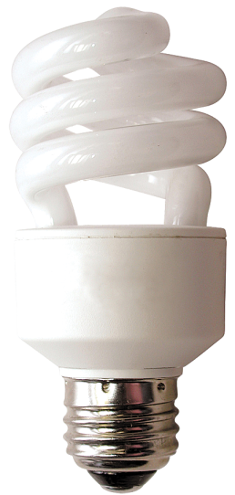
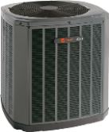
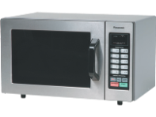
Unique to IoT
Long, complex life cycle
Massed produced in same configuration
Equipment never intended to be connected
Machine-to-machine
Normal C-I-A often reversed
Requires holistic view of device to gateway to cloud and the communications between them
Notes:
C-I-A: Confidentiality, Integrity, Accessibility. Accessibility is often prioritized over Integrity over Confidentiality.

Slide 9
“There is a small—and rapidly closing—window to ensure that IoT is adopted in a way that maximizes security and minimizes risk.” National Security Telecommunications Advisory Committee (NSTAC) Report to the President on the Cybersecurity Implications of the Internet of Things
Notes:
the draft report indicates that if the country fails to adopt security measures it could be dealing with the consequences for generations. Risks include new vulnerabilities and ways to attack critical systems, and an increased ability to use remote access to cause physical destruction.

Slide 10
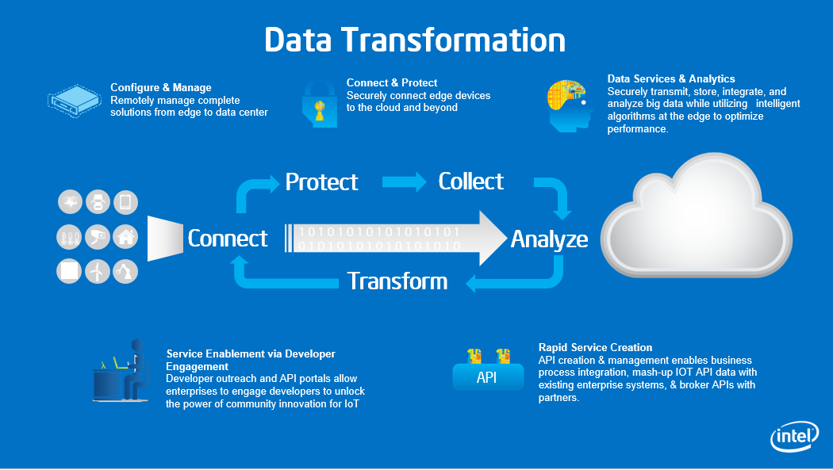
Configure & Manage
Remotely manage complete solutions from edge to data center
Connect & Protect
Securely connect edge devices to the cloud and beyond
Data Services & Analytics
Securely transmit, store, integrate, and analyze big data while utilizing intelligent algorithms at the edge to optimize performance.
Protect
Collect
Connect
1 0 1 0 1 0 1 0 1 0 1 0 1 0 1 0 1
0 1 0 1 0 1 0 1 0 1 0 1 0 1 0 1 0
Analyze
Transform
Service Enablement via Developer Engagement
Developer outreach and API portals allow enterprises to engage developers to unlock the power of community innovation for IoT
Rapid Service Creation
API creation & management enables business process integration, mash-up IOT API data with existing enterprise systems, & broker APIs with partners.
API
Notes:
One of the key elements of IoT solutions is the servive creation layer.
Now that we have connected the Thing to the internet via a gateway of some sort and are processing data to the data center in realtime and are analytizing this data with our big data tools, how do we enable new services to be created??
One are a couple of elements to the Service Creation aspects of IoT. Once is the Service enablement via the Developer Engagement. This includes a developer out reach program and an API portals to allow enterprises to engaged the developers to create applications that tale adnatage of the data. For example, in the case of smart cities, you can have a plethora of sensors that are monitoring traffic, polution, noise etc that are fed into the cloud but only when this data is provided to an App that is used by the city government and/ or the citizens of the city, you have the power of IoT.
The other element really is the API creation and management aspects that allow integration of the data with the existingbusiness processes and the mashup of the data with existing enterprise systems and with other partners data.

Slide 11
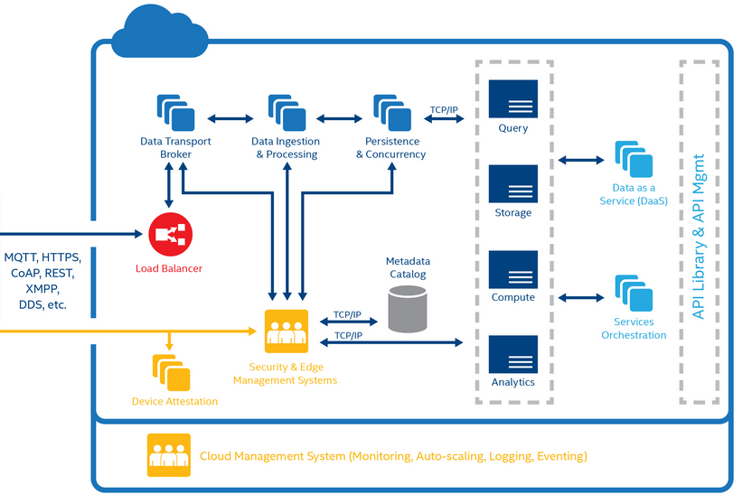
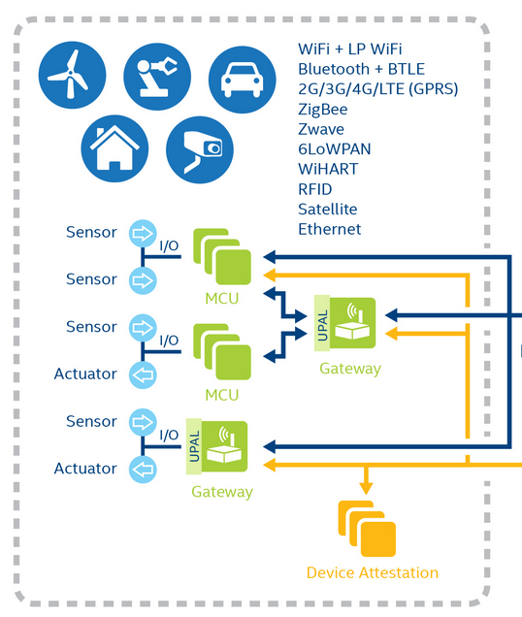

Slide 12
INTERNET OF THINGS: Challenges that could slow IoT growth…
Security & Privacy
Fragmentation of Markets
IT & Control/Data Integration
Legacy Infrastructure
Interoperability & Standards
Notes:
As more devices become connected every day, companies face increased fragmentation, interoperability and security challenges. To address this, Intel is delivering integrated, scalable hardware and software solutions specifically designed to meet diverse market needs from devices to the cloud.

Slide 13
Harden Device
Secure Comms
Manage security
Path to Security
Notes:
By now, many devices are connected → critical mass
Those that are not can be easily connected → low end gateway
How you can unleash value from IoT quickly
85% of the devices are in legacy systems
Compute economics improve… important because:
IoT value depends on → protocol stacks, data filtering, security
Big data has matured → driven by biz intelligence and social media
Learned to turn data into actionable information → key to IoT
Cloud is universal → easy to provision services → very important:
Without cloud you can’t unleash the value of IoT

Slide 14
Security Risks
Cybercrime is a ~$1 Trillion Industry
Big Data
Cloud
Client Continuum
Internet of Things
SECURITY
Crime as a Service
Below the OS
Ransom-ware
Mobile Malware
>15Bn Attack Surfaces by 2020
Big Scale attacks
Notes:
The Internet of Things Has Arrived — And So Have Massive Security Issues” (1/2013)
Malware attack in US power stations go down.
Why should the CXO care about security, after all isn’t this something IT take care of?
Cybercrime cost firms $1 trillion globally – twice the revenue and profit from the entire industry of illegal drug trade/distribution – TWICE.
15 Million Cyber attacks a day, That's how many the U.S. energy department estimates it gets.
This is not about a bunch of pimply 15 year olds in their parents garage - this is about sophisticated organized crime and cyber terrorism.
How much could this cost your business in $?
How long would it take to get your business operational again in the event of a serious breach?
Notes & Data Points:
Data Points:
In 2010 - 11 we saw more attacks than in the past 10 years COMBINED
100,000+ per day new pieces of malware
9,000,000+ per month new botnet infections
5,000,000+ per months new malicious websites
Unknown number of non-detectable stealth attacks
To put the Malware numbers into context regards growth:
McAfee currently sees about 100,000 pieces of new malware every single day
A year ago, it was about half

Slide 15
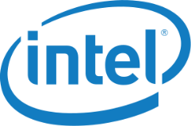
IOT Industry Open Standards
“…focused on breaking down the barriers of technology silos to support better access to big data with improved integration of the physical and digital worlds.”
“…enable organizations to more easily connect and optimize assets, operations and data to drive agility and to unlock business value across all industrial sectors.”
* Other names and brands may be claimed as the property of others.

Slide 16
SUMMARY
Secure the Endpoint
Secure the Communications
Monitor and Manage
Secure Cloud Services
Notes:
Goals: Protect connected devices across entire lifecycle: boot up, runtime, shutdown, recovery. Enable security controls and countermeasures on Endpoints to increase the security posture. Enable Gateways to be proxy for security on brownfield Endpoints.
Goals: Manage and Monitor all communications between endpoints. Provide network security controls to monitor and secure the traffic. Enable dynamic mutual authentication, authorization, confidentiality, and integrity across the communications as defined by policy. Embed communication controls into endpoints.
Goals: Enable independent communication channels (separate from the Operational Flows) to back-end services via DXL. South-of-Gateway communication delivered via native protocols (e.g. OMA-DM).
Goals: Provide Edge Management capabilities to manage Endpoints via Policy. Enable Device Attestation services. Gather events from Endpoints to gain Situational Awareness. Create a feedback loop to enable security to react to the environment. Build proactive security response capabilities to protect devices not yet even under attack.
Goal: Provide Cloud-based Data Services and Orchestration. Enable Intelligence capabilities to detect threats in the environment. Enable Cloud Services API orchestration and management to build out interconnectivity between Services. Offer Security as a Service (SaaS) regardless of the Operational Vertical.

Slide 17
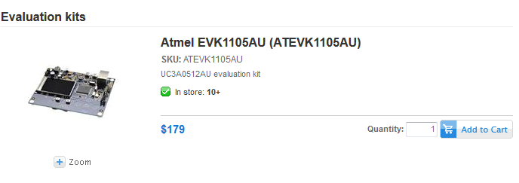
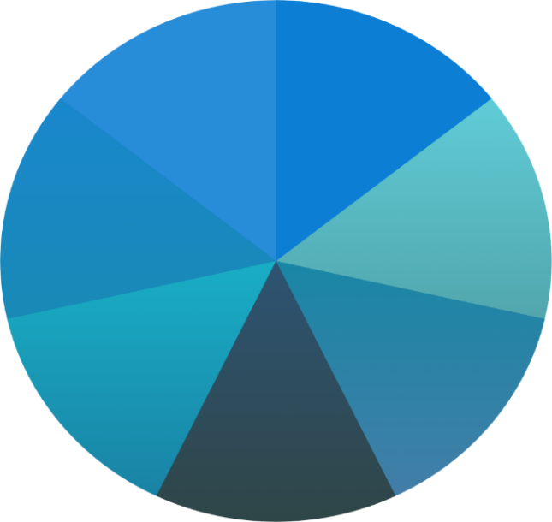
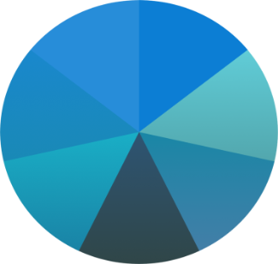
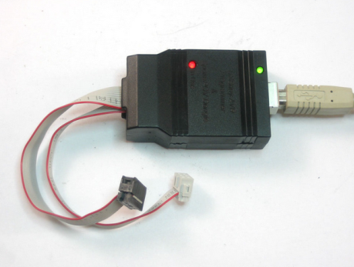
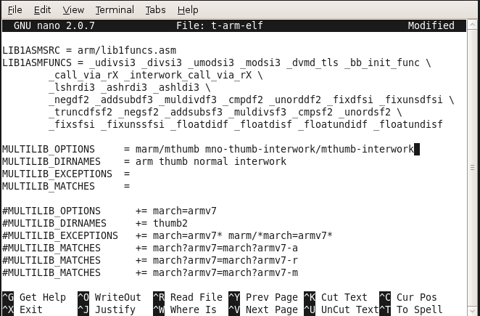
Arduino impact in maker space
Before
Learn, buy, solder together components (caps, controllers, chips, regulators etc)
Learn complex toolchains, buy specialized hardware
After
Open sourced HW & SW
Huge online community & ecosystem
Radically simplified development
3D Printing
Micro Funding
Compute Platforms
Millions of Makers Worldwide
Markets
Physical Spaces
Distis
Online Communities
Notes:
An evolution of computing is emerging.
The intersection of a few key trends suggest now is the time for entrepreneurs and inventors of all types to create tomorrow’s computing devices.
The open software movement is now mainstream.
3D printing can almost support consumer-grade products.
A whole new set of crowd source funding, Incubators, distributors and other communities have been created and are thriving.
However, nothing has been done on the core computing side to support this new world. This is where Intel® Edison comes in.
Barriers to entry have lowered to the point where nearly anyone can participate in this new market. Intel’s opportunity is to build a product, service, support and ecosystem to support the thousands of ideas on the cusp of being invented.
Right now there is a rebirth of computing emerging, the maker movement has grown exponentially in the past several years. And now 3D printing is becoming a reality, making it easy for inventors and entrepreneurs to realize their vision.
Barriers to market entry have lowered substantially with things like crowd source funding, and software development and distribution now possible at absolutely incredible scale, ubiquity, and speed. This rebirth could be the next strategic inflection point in computing – sparking a massive wave of innovation from wearables to the Internet of Things.
However, nothing has been done on the core computing side to support this world. This is where Intel® Edison comes in.
Barriers to entry have lowered to the point where nearly anyone can participate in this new market. Intel’s opportunity is to build a product, service, support and ecosystem to support the thousands of ideas on the cusp of being invented. Intel® Edison is the world’s first development platform uniquely designed bring powerful performance and capabilities to anyone wanting to rapidly prototype and produce computing products, lowering the barriers to entry for all.

Slide 18
3D Printing
Micro Funding
Compute Platforms
Millions of Makers Worldwide
Markets
Physical Spaces
Distis
Online Communities
Notes:
An evolution of computing is emerging.
The intersection of a few key trends suggest now is the time for entrepreneurs and inventors of all types to create tomorrow’s computing devices.
The open software movement is now mainstream.
3D printing can almost support consumer-grade products.
A whole new set of crowd source funding, Incubators, distributors and other communities have been created and are thriving.
However, nothing has been done on the core computing side to support this new world. This is where Intel® Edison comes in.
Barriers to entry have lowered to the point where nearly anyone can participate in this new market. Intel’s opportunity is to build a product, service, support and ecosystem to support the thousands of ideas on the cusp of being invented.
Right now there is a rebirth of computing emerging, the maker movement has grown exponentially in the past several years. And now 3D printing is becoming a reality, making it easy for inventors and entrepreneurs to realize their vision.
Barriers to market entry have lowered substantially with things like crowd source funding, and software development and distribution now possible at absolutely incredible scale, ubiquity, and speed. This rebirth could be the next strategic inflection point in computing – sparking a massive wave of innovation from wearables to the Internet of Things.
However, nothing has been done on the core computing side to support this world. This is where Intel® Edison comes in.
Barriers to entry have lowered to the point where nearly anyone can participate in this new market. Intel’s opportunity is to build a product, service, support and ecosystem to support the thousands of ideas on the cusp of being invented. Intel® Edison is the world’s first development platform uniquely designed bring powerful performance and capabilities to anyone wanting to rapidly prototype and produce computing products, lowering the barriers to entry for all.

Slide 19
Do embedded developers care about SW tools?
Commercial Developers: Silicon price & performance top the list.
But tools & software matter.
Source: 2014 Embedded Engineer Survey, VDC Research
Makers:
Ease of use, software tools lead their HW selection process
Source: VDC Research, 2014
Notes:
IoT and embedded are tied together. Huge dynamic diverse space.

Slide 20
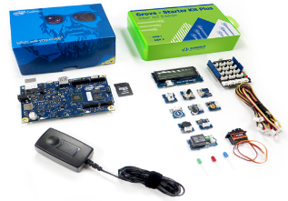
Intel® IoT Developer Kit with Intel® Galileo & Intel® Edison boards together with easy to use hardware, software, tools, cloud services
Includes Arduino libraries, Wyliodrin, Intel® XDK IoT Edition and eval version of Intel® System Studio
IoT Roadshows & Hackathons
On-line community for learning, building, sharing Intel Developer Zone for IoT
A comprehensive program for hobbyists, students and entrepreneurial developers that delivers everything a software developer needs to quickly and easily turn ideas into solutions for the Internet of Things (IoT)

Slide 21
Intel® IoT SDK

Slide 22
Target audience and developer path
Arduino
Developer
Visual
Programming
JavaScript
Developer
C / C++
Developer
OS/Boot Image
Yocto Linux
SPI
Yocto Linux
Yocto Linux
Yocto Linux, Windows, VxWorks, WR Linux
IDE
Dev Env
Arduino IDE
Win / Mac/ Linux
Wyliodrin
Web
XDK
Win/ Mac/ Linux
Eclipse
Win/ Mac / Linux
Programming Language
Arduino Sketch
C++
Visual
Python
JavaScript
(Node JS)
C/ C++
Hardware
Quark (Galileo, Edison)
Quark (Galileo, Edison)
Quark (Galileo, Edison), Atom
Quark, Atom, Core, Xeon
Tools/ Libraries
Arduino Libraries
Wyliodrin
Intel® XDK IoT Edition
Intel® System Studio
Wind River
Maker
Beginner
Intermediate
Advanced &
Professional
Notes:
hypercard
Transition from XDK to ISS, clearly state
Show where each tool plays a role, show them examples of success stories (summary slide on hackathons, outcome, who has purchased ISS, XDK’s use and comments)
Goal: show SSG understands this market, have well thought out solutions for different needs, are ready to work with you.
Most people start their IoT journey (from idea to designs) from left to right.
How to get contacts, eval versions etc.
WR: use WR tools if you use Vxworks/WRL. You get WR adaptation of eclipse plus GCC. Workbench is provided for all target HW platforms.

Slide 23
Wyliodrin* Visual Programming (for Edison and Galileo)
Select your peripheral/sensor
Simply drag and drop ‘blocks’
Tool automatically creates Javascript code
www.wyliodrin.com/galileo

Slide 24
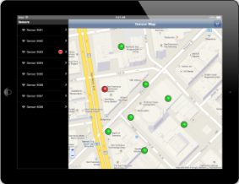
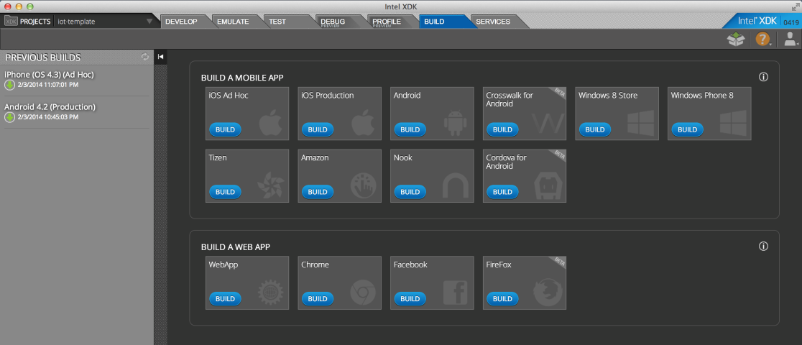
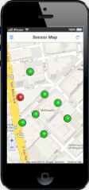
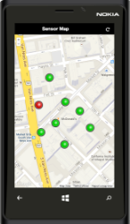
Intel® XDK
Intel® XDK:
160k: registered developers, growing rapidly
Every 33 sec: a developer builds an app using XDK
>10M: app downloads, built using XDK
Notes:
XDK is our HTML5 app builder tool, allows developers to easily create apps that they can publish in multiple app stores (google play, amazon, apple store, microsoft’s windows store etc)
Screenshot: allows developers to automatically build their app on multiple targeted platforms/form factors – phones, tablets & browsers.
Repsonsive design – app responds to the characteristics of the device its running on.
A developer builds an app using XDK every 33 seconds (18k/week)
160k registered users
2500 apps in google play stores,
>10M apps built using XDK have been downloaded
1600 registered users on XDK IoT edition

Slide 25
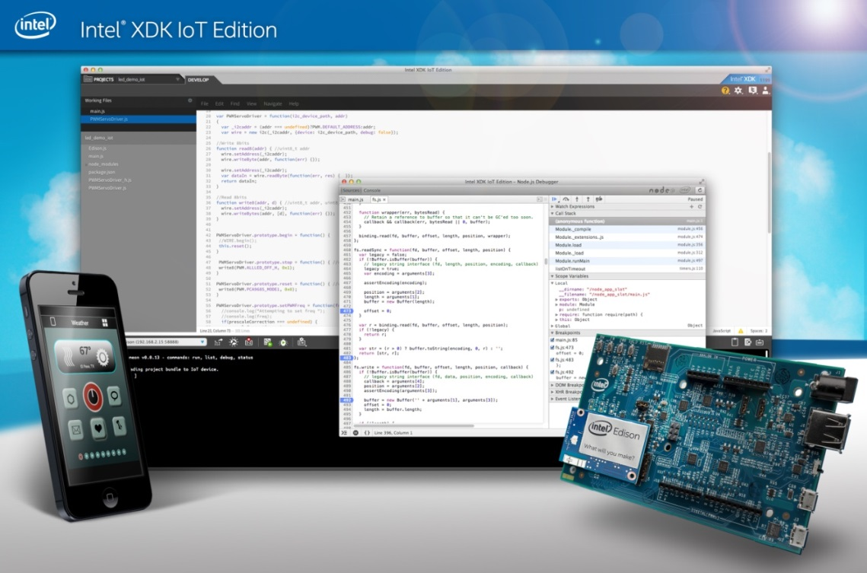
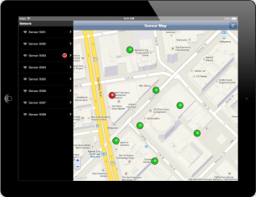
Intel® XDK IoT Edition at: https://software.intel.com/en-us/html5/xdk-iot
Intel® XDK IoT Edition
Design companion app UI in HTML5 for the IoT device. Control via phone/tablet/browser
Program the device (Edison or Galileo) using Node.JS
Visualize & analyze data generated from a system of IoT devices
Notes:
Javascript is not just for HTML5 any more, also used for device programming – which is what node.js allows you to do
Intel has been contributing to javascript to make it run better on intel cpu’s (ex SIMD extensions)
You can put code on the device using node.js
Or you can interact with the device from the phone
Or you can visualize the data

Slide 26
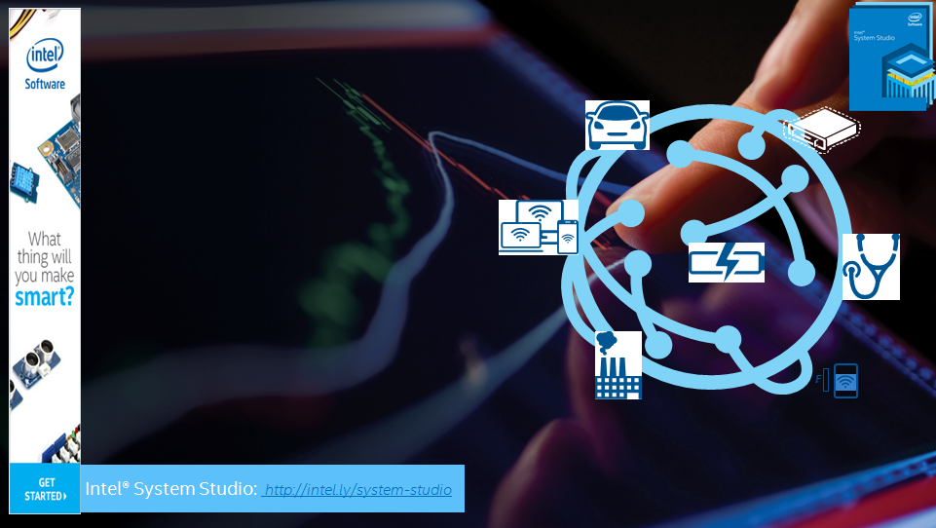
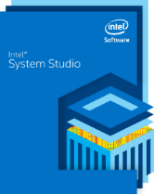
Intel® System Studio
Deliver next-gen IoT systems and applications
Accelerate time to market
Strengthen System Reliability
Boost power efficiency and performance
Software tools to Build, Debug and Tune IoT systems
F
Notes:
ISS is a commercial tool suite for IA based systems. Dedicated tool chain for embedded, IoT type market that supports multiple target and host OS’s. Key benefits of the tool chain are ttm, reliability, power/perf.
Tool chain provides technologies for build, debug and tune phases of system development. Customers are predominatly using hardware from IoTG, CSIG, CCG, NDG– telecom, mobile, transportation, retail, medical etc markets
For C/C+_, software tools to build, debug, test IoT Systems

Slide 27
Intel® System Studio 2015 Components
 |  | Target OS Support
 |  | Linux* ^{1, 5} |  |  | Android* ⁵ |  |  | Windows* |  | VxWorks*
Category | Component | ^{Composer Edition} | ^{Professional Edition} | ^{Ultimate Edition} | ^{Composer Edition} | ^{Professional Edition} | ^{Ultimate Edition} | ^{Composer Edition} | ^{Professional Edition} | ^{Composer Edition}
Host Operating Systems |  | Linux*, Windows* |  |  | Linux*, Windows* |  |  | Windows* |  | Linux*, Windows*
Integrated Development Environment |  | Eclipse*, Wind River* Workbench* |  |  | Eclipse* |  |  | Visual Studio* |  | Wind River* Workbench*
Compiler & Libraries | Intel® C++ Compiler | √ | √ | √ | √ | √ | √ | √ | √ | √ ²
 | Intel® Integrated Performance Primitives | √ | √ | √ | √ | √ | √ | √ | √ | √ ²
 | Intel® Math Kernel Library | √ | √ | √ |  |  |  | √ | √
 | Intel® Threading Building Blocks | √ | √ | √ | √ | √ | √ | √ | √
Application Debugger | Intel-enhanced GDB* Application Debugger | √ | √ | √ | √ | √ | √
Analyzers | Intel® VTune™ Amplifier for Systems |  | √ | √ |  | √ | √ |  | √
 | Intel® Energy Profiler |  |  |  |  | √ | √ |  | √
 | System Analyzer |  |  |  |  | √ | √ |  | √
 | Frame Analyzer ⁴ |  |  |  |  | √ | √ |  | √
 | Platform Analyzer ⁴ |  |  |  |  | √ | √ |  | √
 | Intel® Inspector for Systems |  | √ | √ |  |  |  |  | √
System Debugger | Intel® System Debugger (JTAG) ³ |  |  | √ |  |  | √
¹ Linux*, Embedded Linux, Wind River* Linux*, Yocto Project*, Tizen*
² Delivered with Wind River* VxWorks* platform* ³ Via Intel® ITP-XDP3 probe, OpenOCD*, Macraigor* usb2demon* and EDKII* for UEFI*
⁴ Available on Windows* host only
⁵ Linux* and Android* target support available in a single product
Notes:
Here is a mapping of ISS components to target Operating Systems and packages.
The key components of ISS are grouped into
The key differentiator between Ultimate Edition and Pro Edition is the JTAG-based Intel System Debugger – a solution that OEMs, and System Integrators are seeking for.
The Linux and Android target support comes with one package, either Composer, Professional or Ultimate solution. As mentioned, Windows target support is a new offering we are providing with ISS 2015.
For those who develop embedded systems based on Wind River VxWorks, a compiler and certain libraries are available too. These can be obtained through Wind River Systems

Slide 28
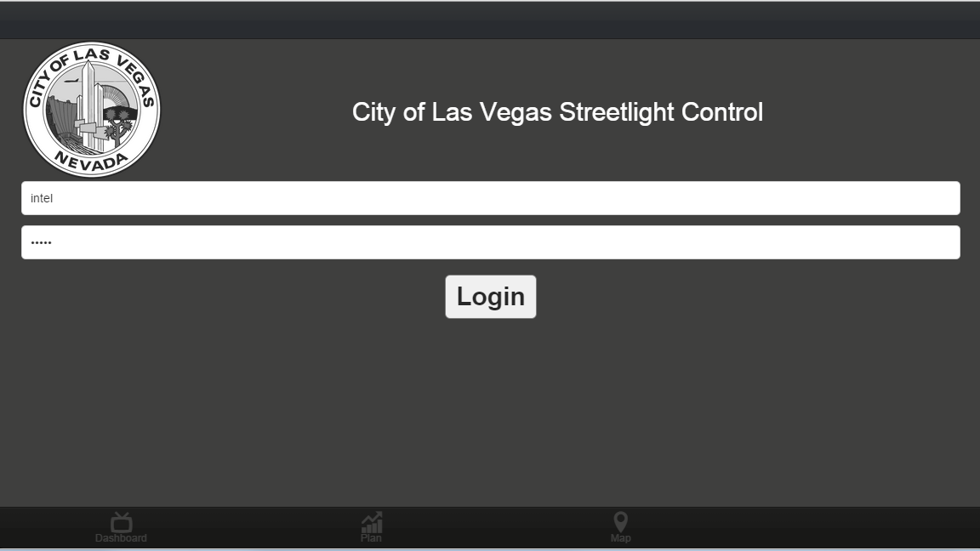

Slide 29
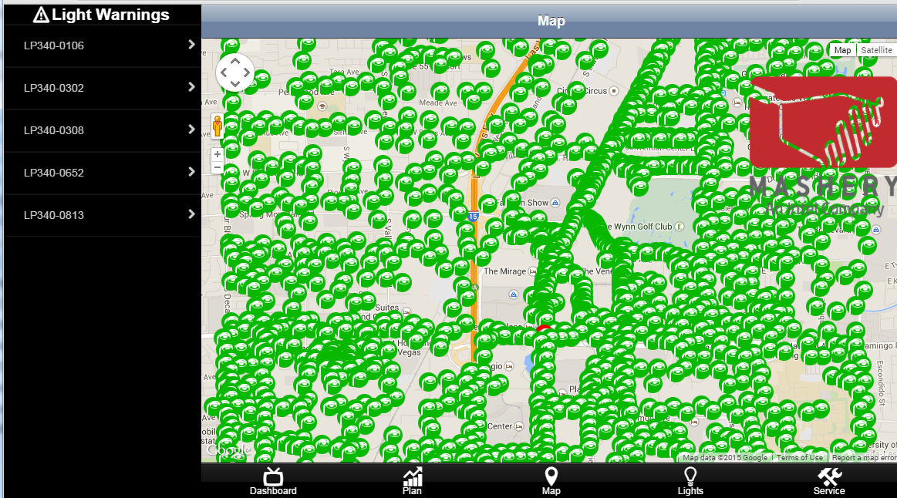

Slide 30
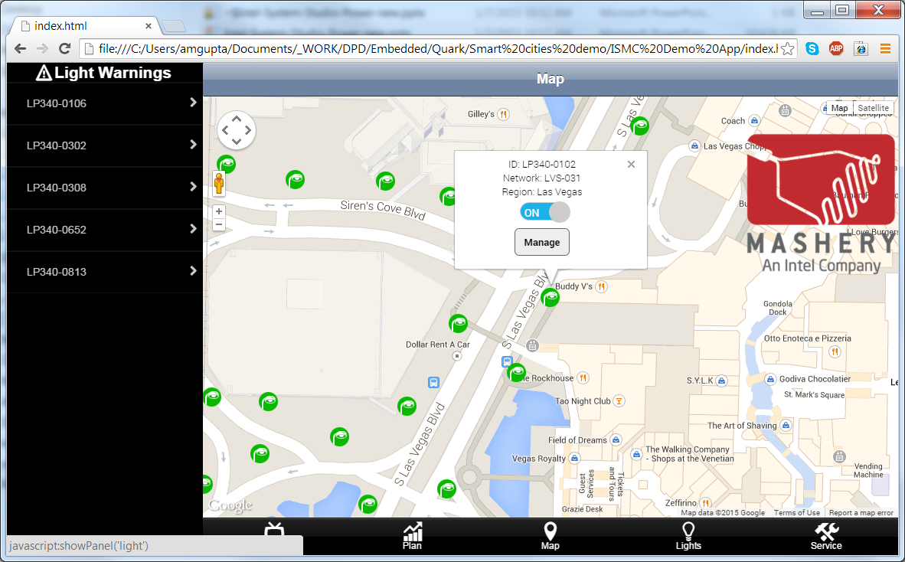

Slide 31
Thank You

